Slide 1
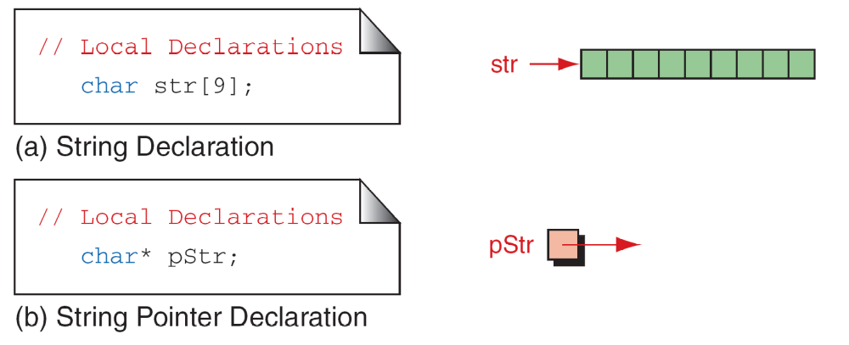
FIGURE 11-9 Defining Strings

Slide 2
Note
Memory for strings must be allocated before the
string can be used.

Slide 3
文件相关的读入输出都没讲

Slide 4
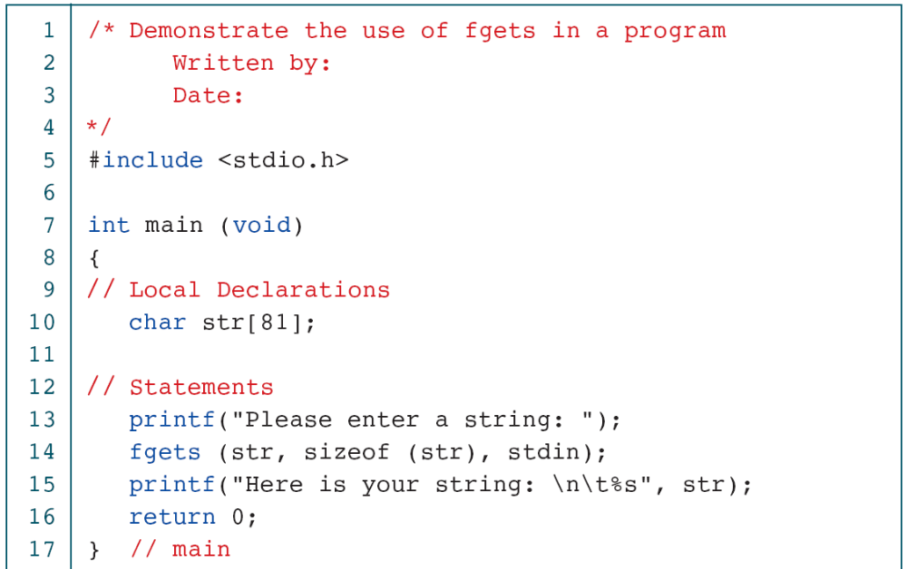
PROGRAM 11-5
Demonstrate fgets Operation

Slide 5
PROGRAM 11-5
Demonstrate fgets Operation

Slide 6
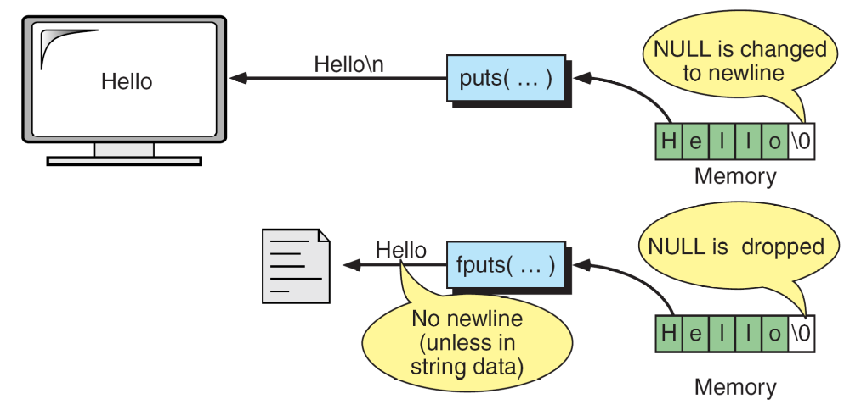
FIGURE 11-12 puts and fputs Operations

Slide 7
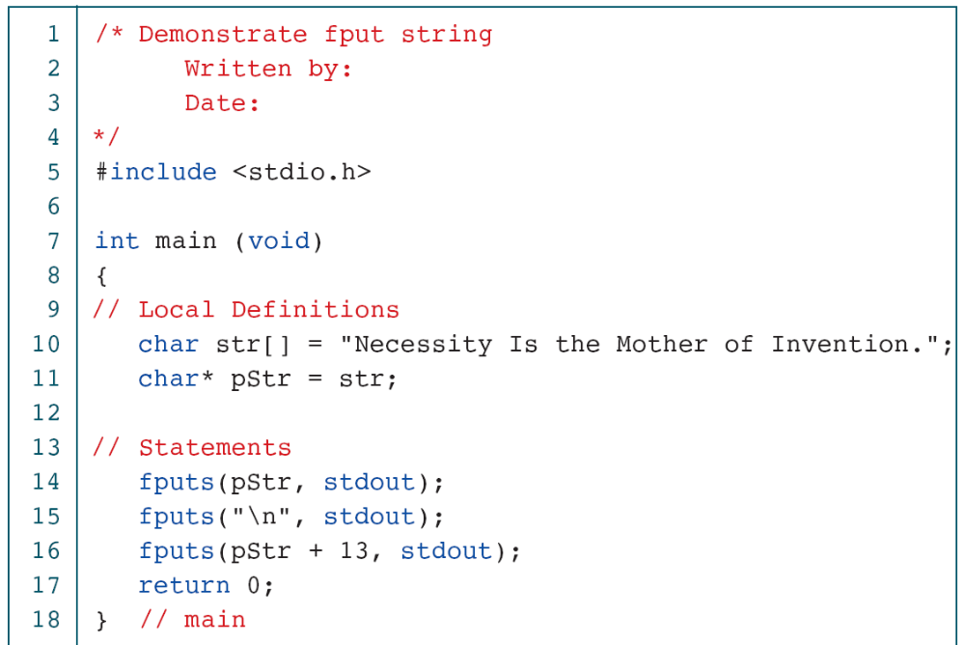
PROGRAM 11-6
Demonstration of Put String

Slide 8
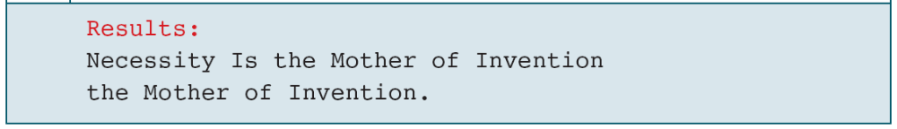
PROGRAM 11-6
Demonstration of Put String

Slide 9
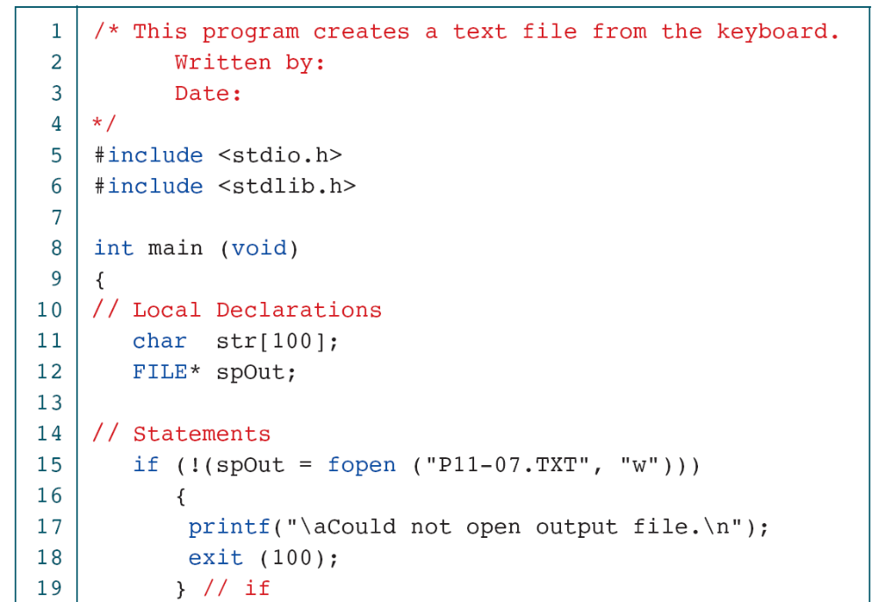
PROGRAM 11-7
Typewriter Program

Slide 10
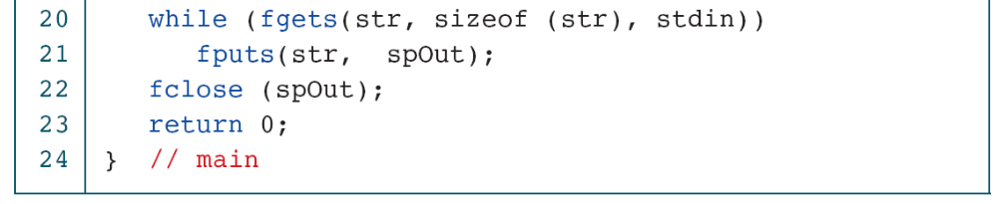
PROGRAM 11-7
Typewriter Program

Slide 11
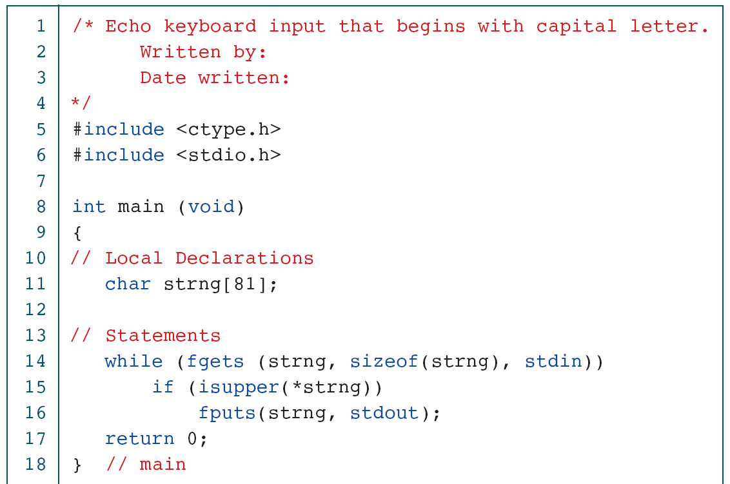
PROGRAM 11-8
Print Selected Sentences

Slide 12
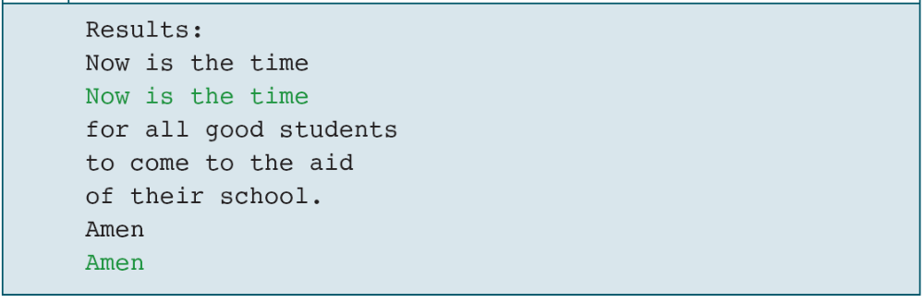
PROGRAM 11-8
Print Selected Sentences

Slide 13
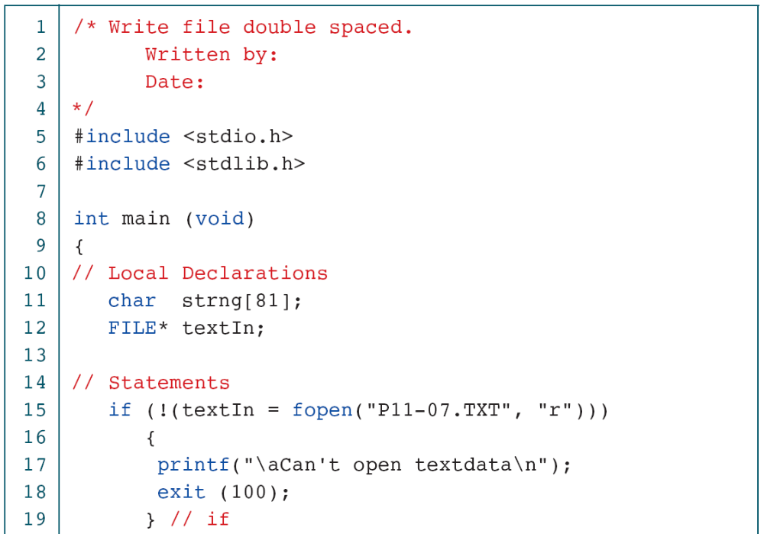
PROGRAM 11-9
Print File Double spaced

Slide 14
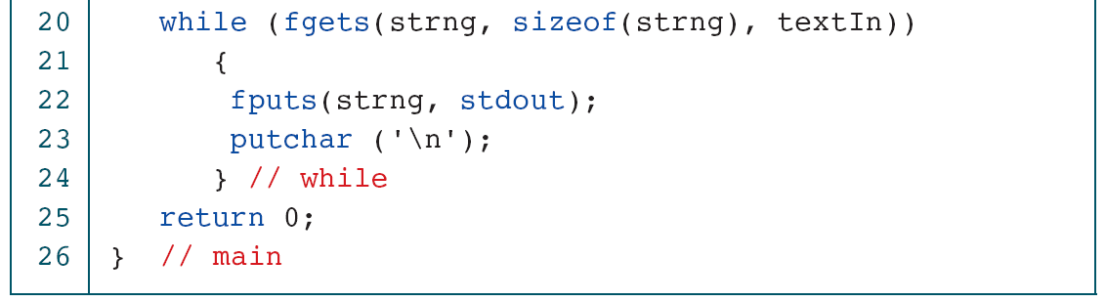
PROGRAM 11-9
Print File Double spaced

Slide 15
11-4 Arrays of Strings
When we discussed arrays of pointers in Chapter 10, we introduced the concept of a ragged array. Ragged arrays are very common with strings. Consider, for example, the need to store the days of the week in their textual format. We could create a two-dimensional array of seven days by ten characters, but this wastes space.

Slide 16
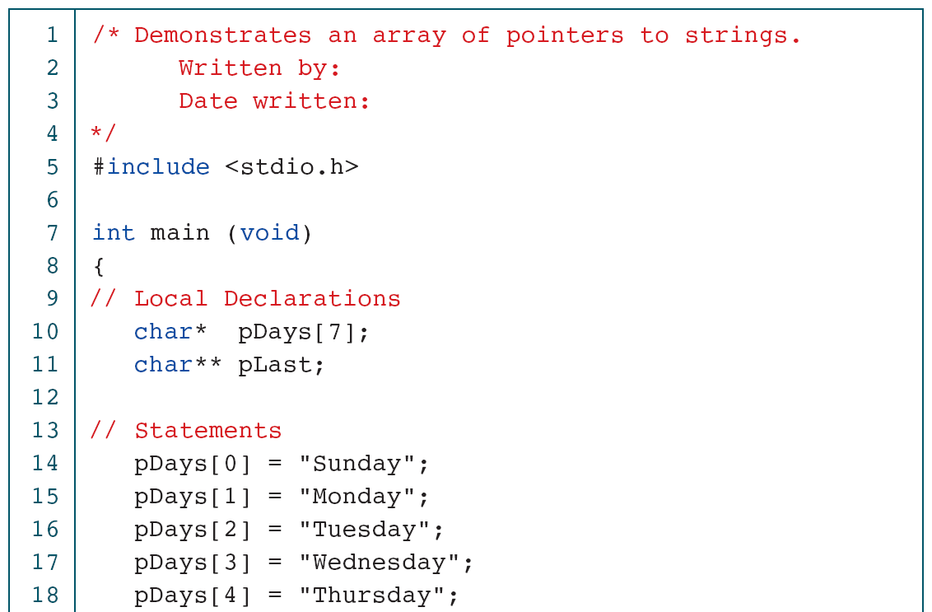
PROGRAM 11-10
Print Days of the Week

Slide 17
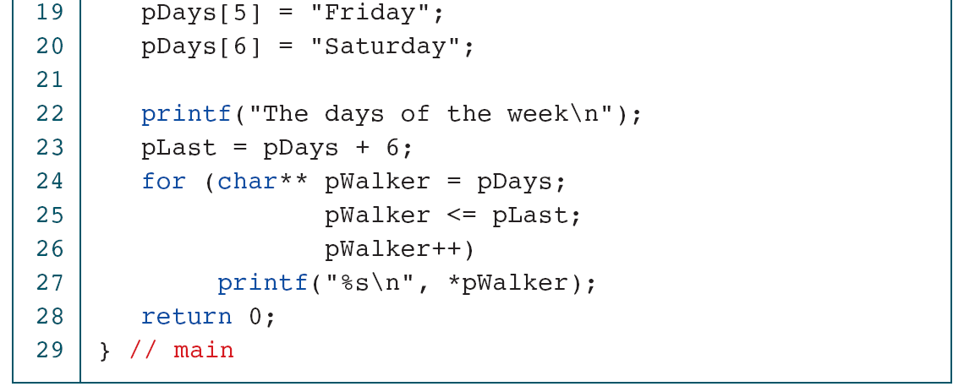
PROGRAM 11-10
Print Days of the Week

Slide 18
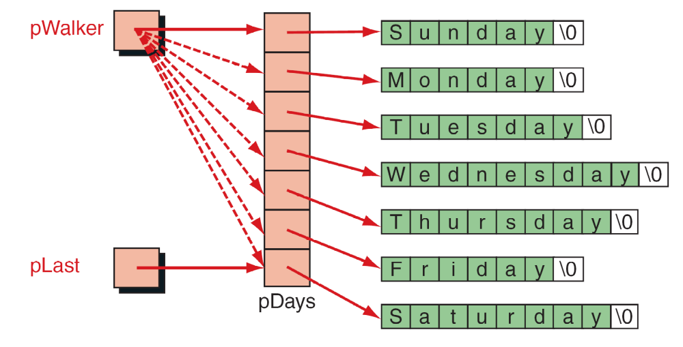
FIGURE 11-13 Pointers to Strings

